Slide 1
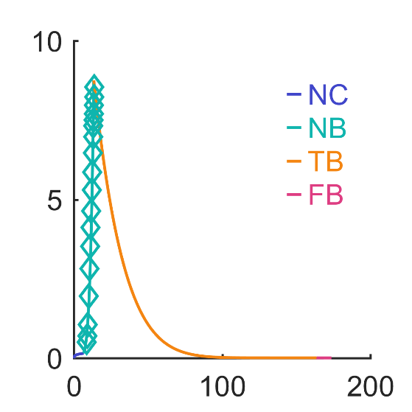
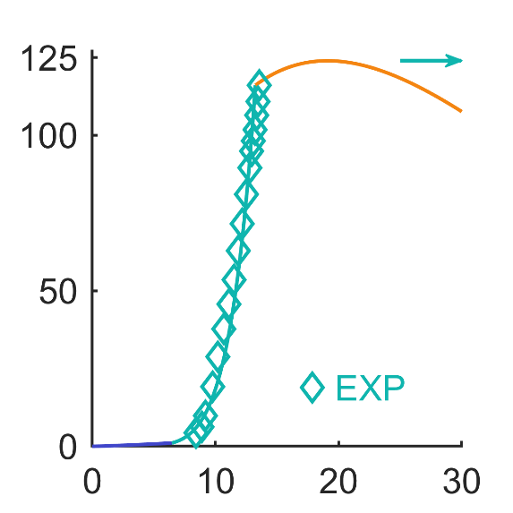
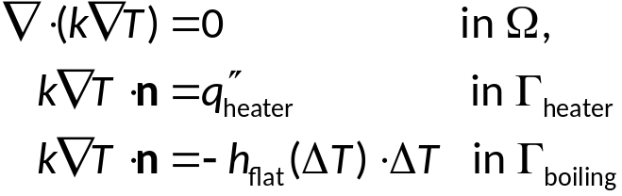
Topology Optimization Approach
Heat transfer model for boiling heat sink
q’’
Heat input at Г_{heater}
Boiling
boundary condition
h(ΔT) at Г_{boiling}
h
Heat conduction in Ω
ΔT
ΔT
Flat surface boiling calibration experiments
Extract h_{flat}(ΔT)
from flat surface boiling experiments
Evaluate heat sink performance
A boiling calibration experiment is used to extract the heat transfer function h_{flat}(ΔT), which serves as the boiling boundary condition for the heat sink conduction problem

Slide 2


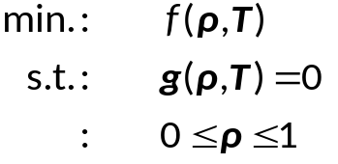

Topology Optimization Formulation
Heat transfer model for boiling heat sink
Design problem for topology optimization
Topology optimization strategy
Heated area
Heat input
Boiling
boundary condition
h(ΔT)
(from boiling test)
Heat conduction
Design space:
(voxel representation)
Boiling heat sink governing equations
Converted design problem
Topology optimization formulations
f: Target function
g: Governing physics
discretization
ρ: Physical density
T: Temperature

Slide 3
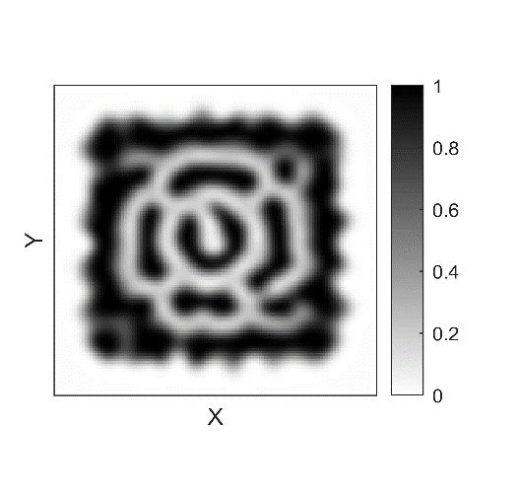

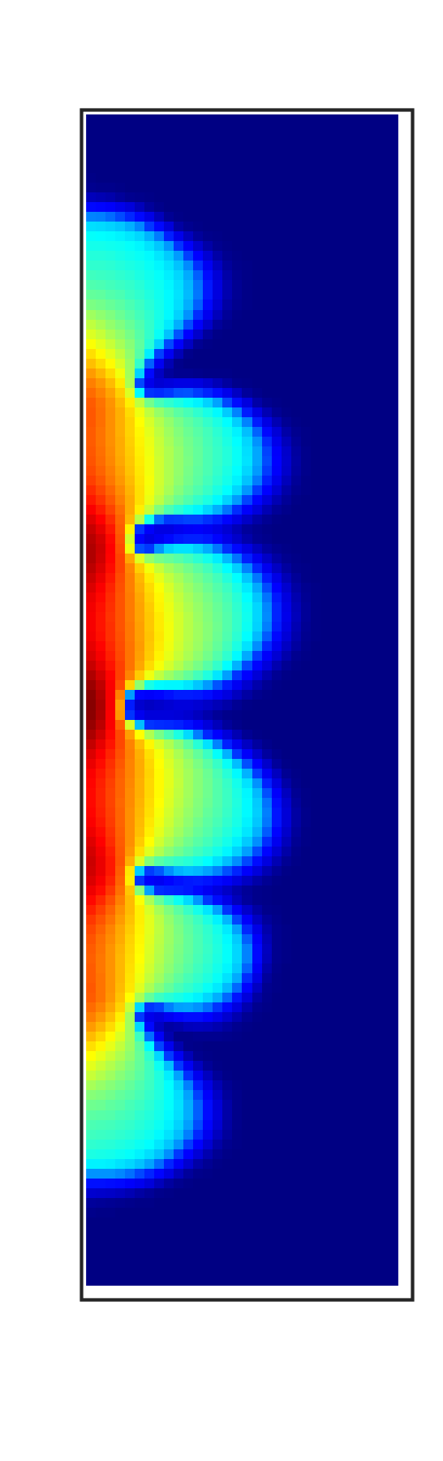
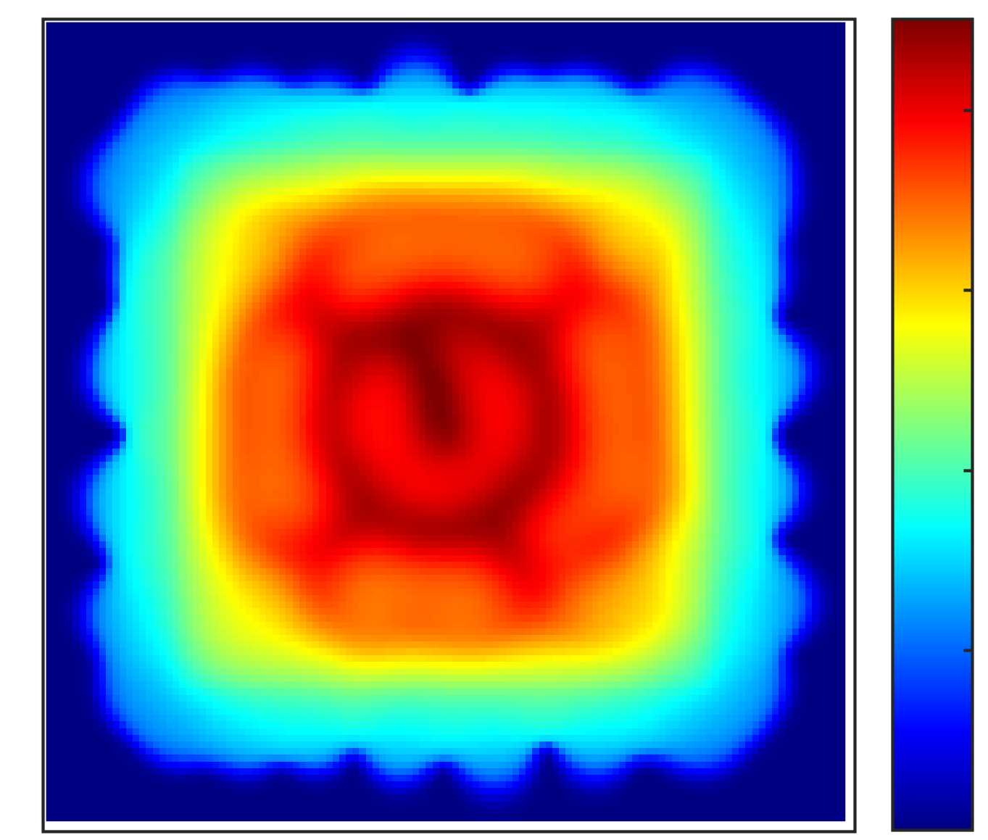
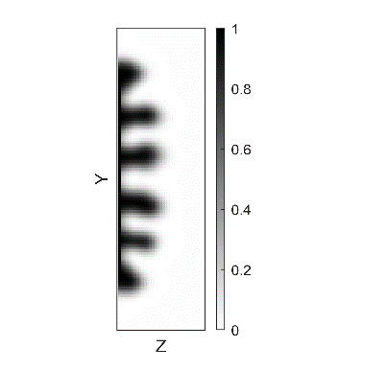
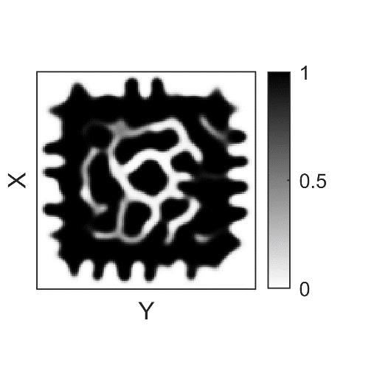
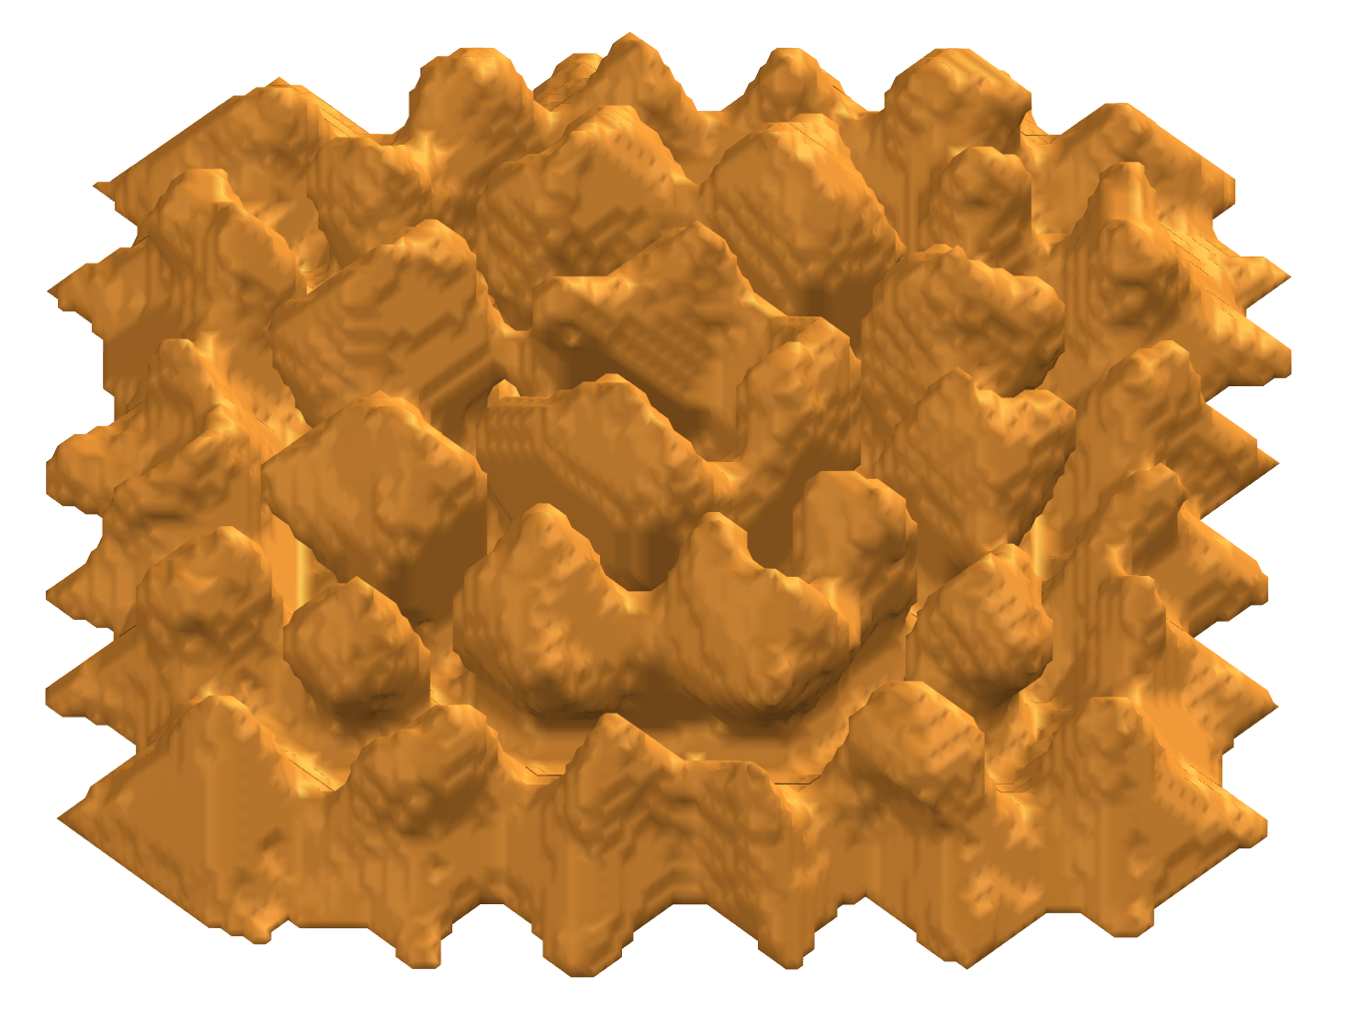
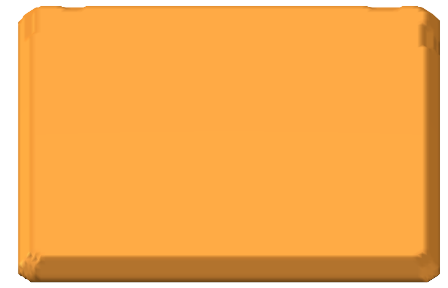
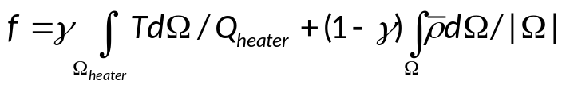
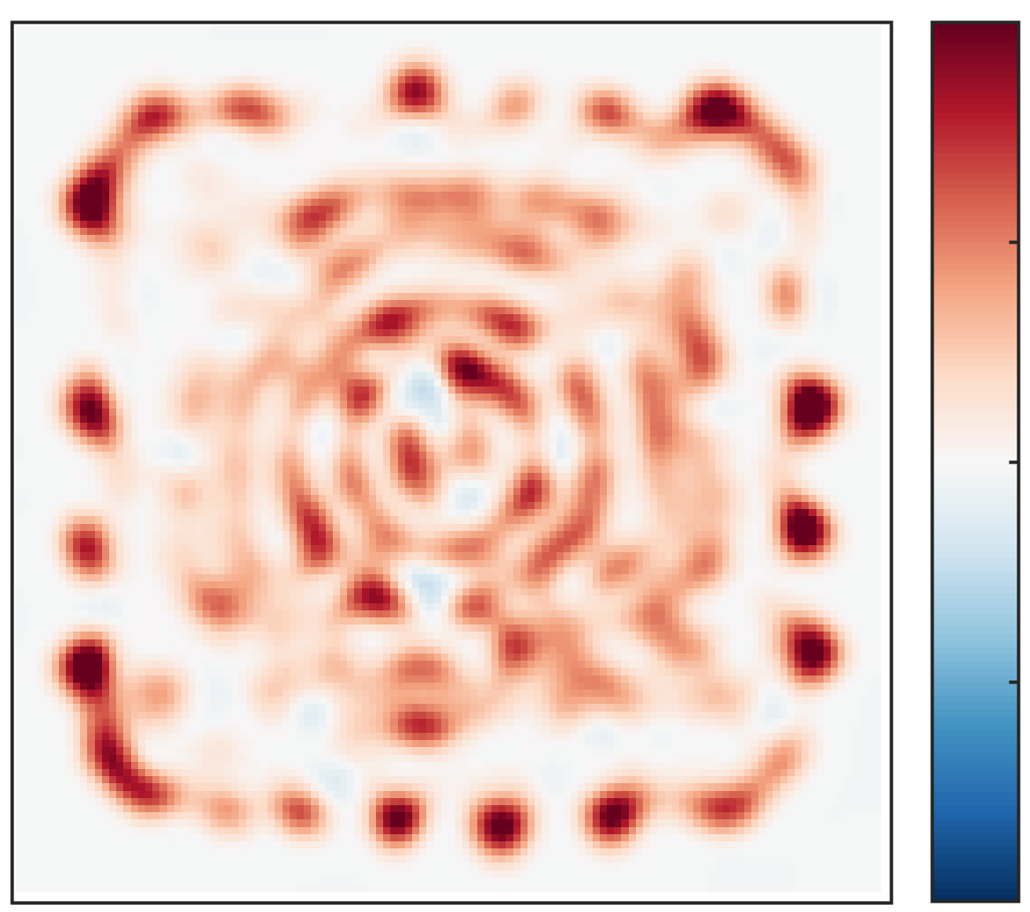

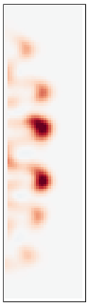
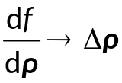
Topology Optimization Workflow
ΔT
1
0
Initialization
Final Design
Intermediate Design
Heat Transfer Analysis
Iterations
Optimization Target
Sensitivity Analysis
Topology Optimization Formulations
f: Target function
0.02
g: Governing physics
ρ: Physical density
T: Temperature
-0.02

Slide 4
Introduction to Boiling Heat Sink Topology Optimizations
“Topology optimization is a mathematical method that optimizes the material distribution within a design space for a given objective function.” [1]
Mathematical method: The formulation of the problem needs to be clearly defined
Material distribution: The optimized design is given as a map of material distribution within a design space.
Objective function: the target of topology optimization is to minimize the defined objective function.
How to use topology optimization to design boiling heat sink?
S. Ozguc, L. Pan, J. A. Weibel, IJHMT, 2021

Slide 5


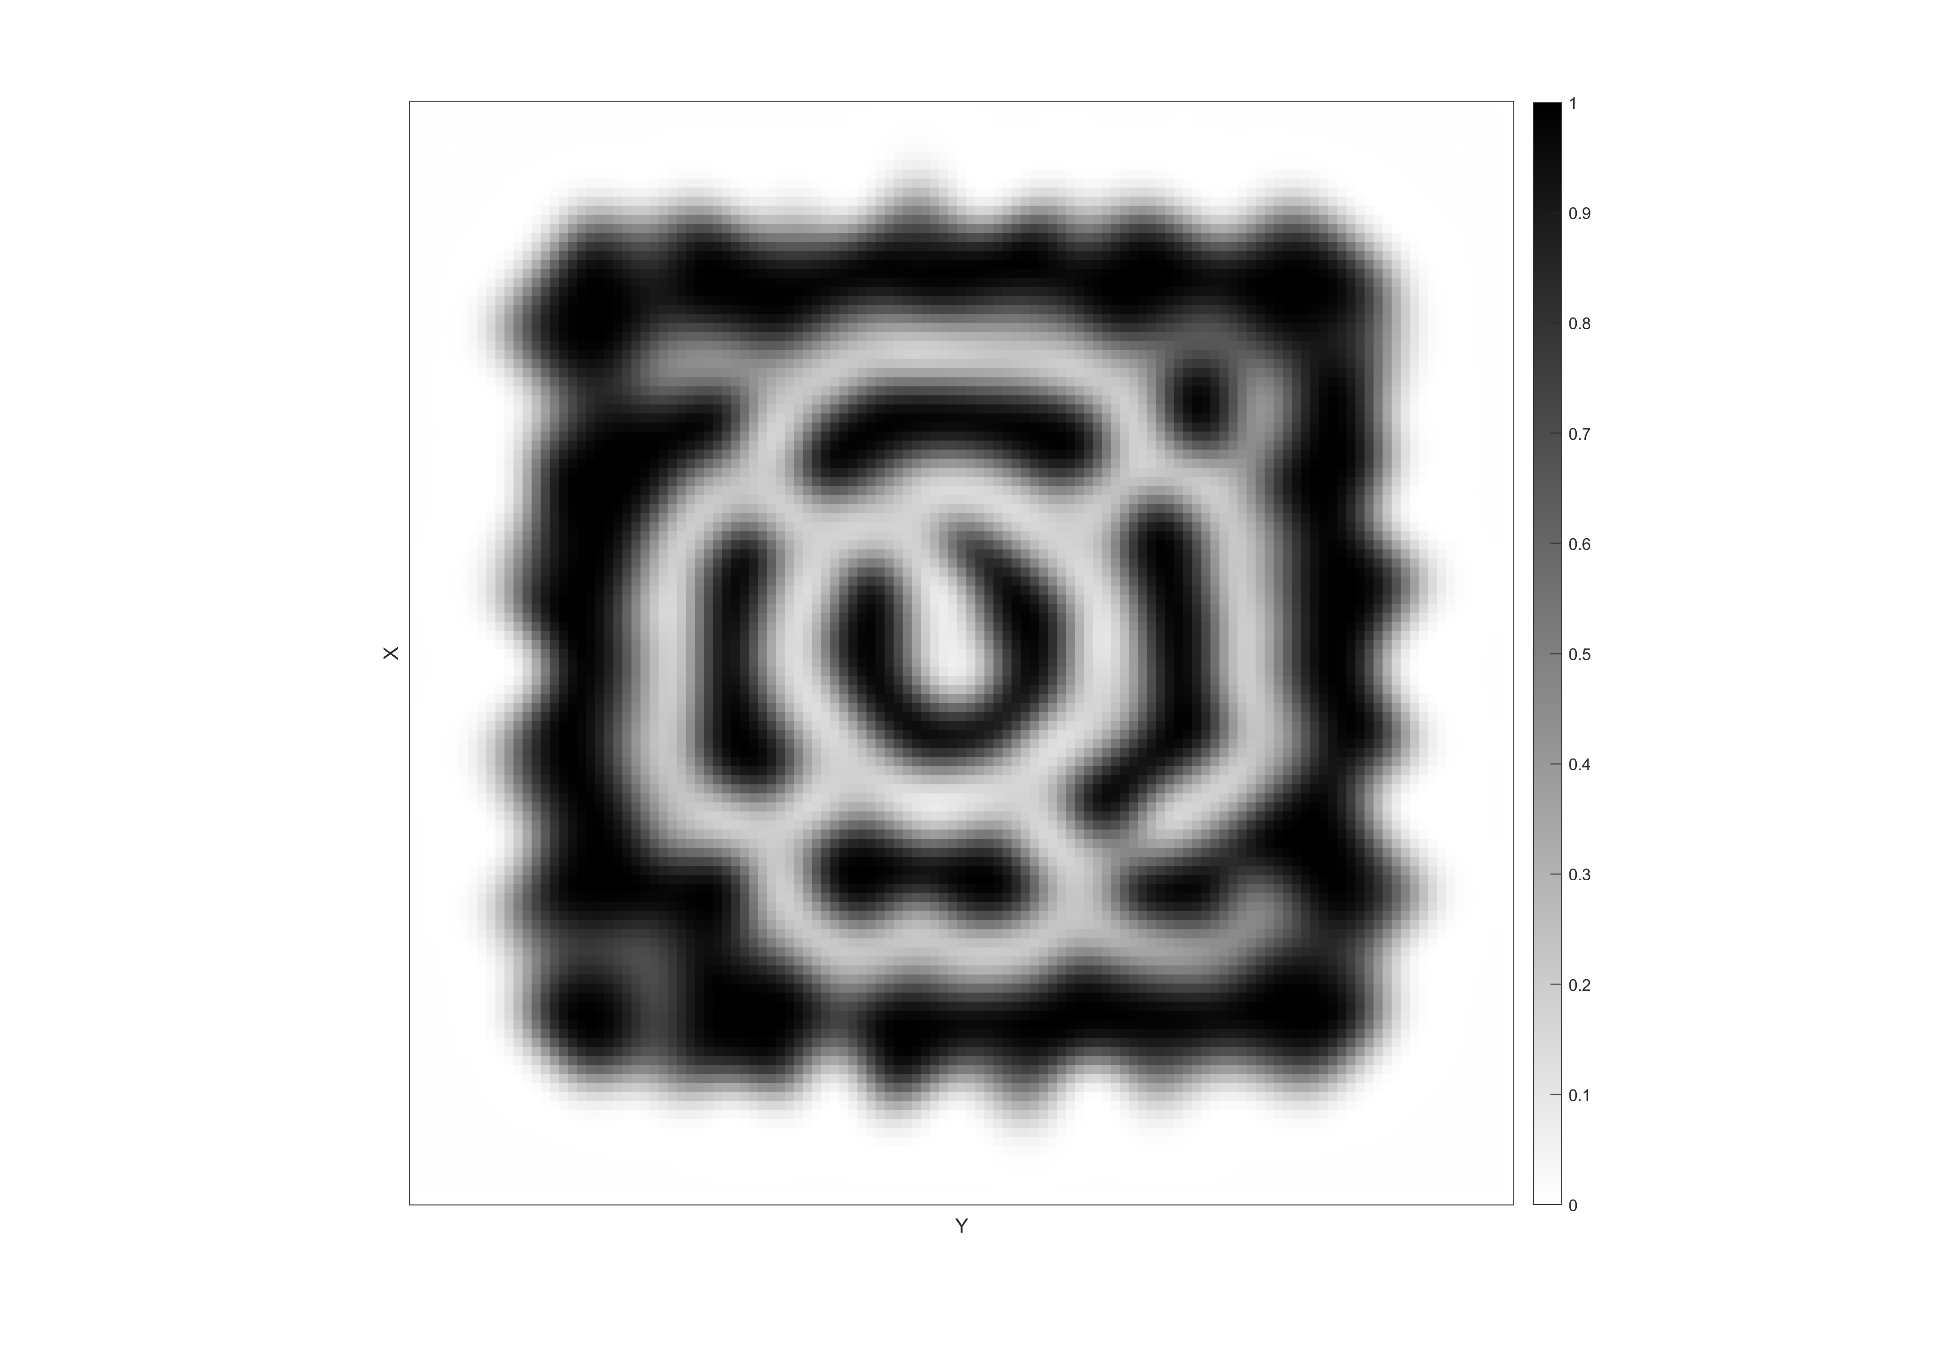
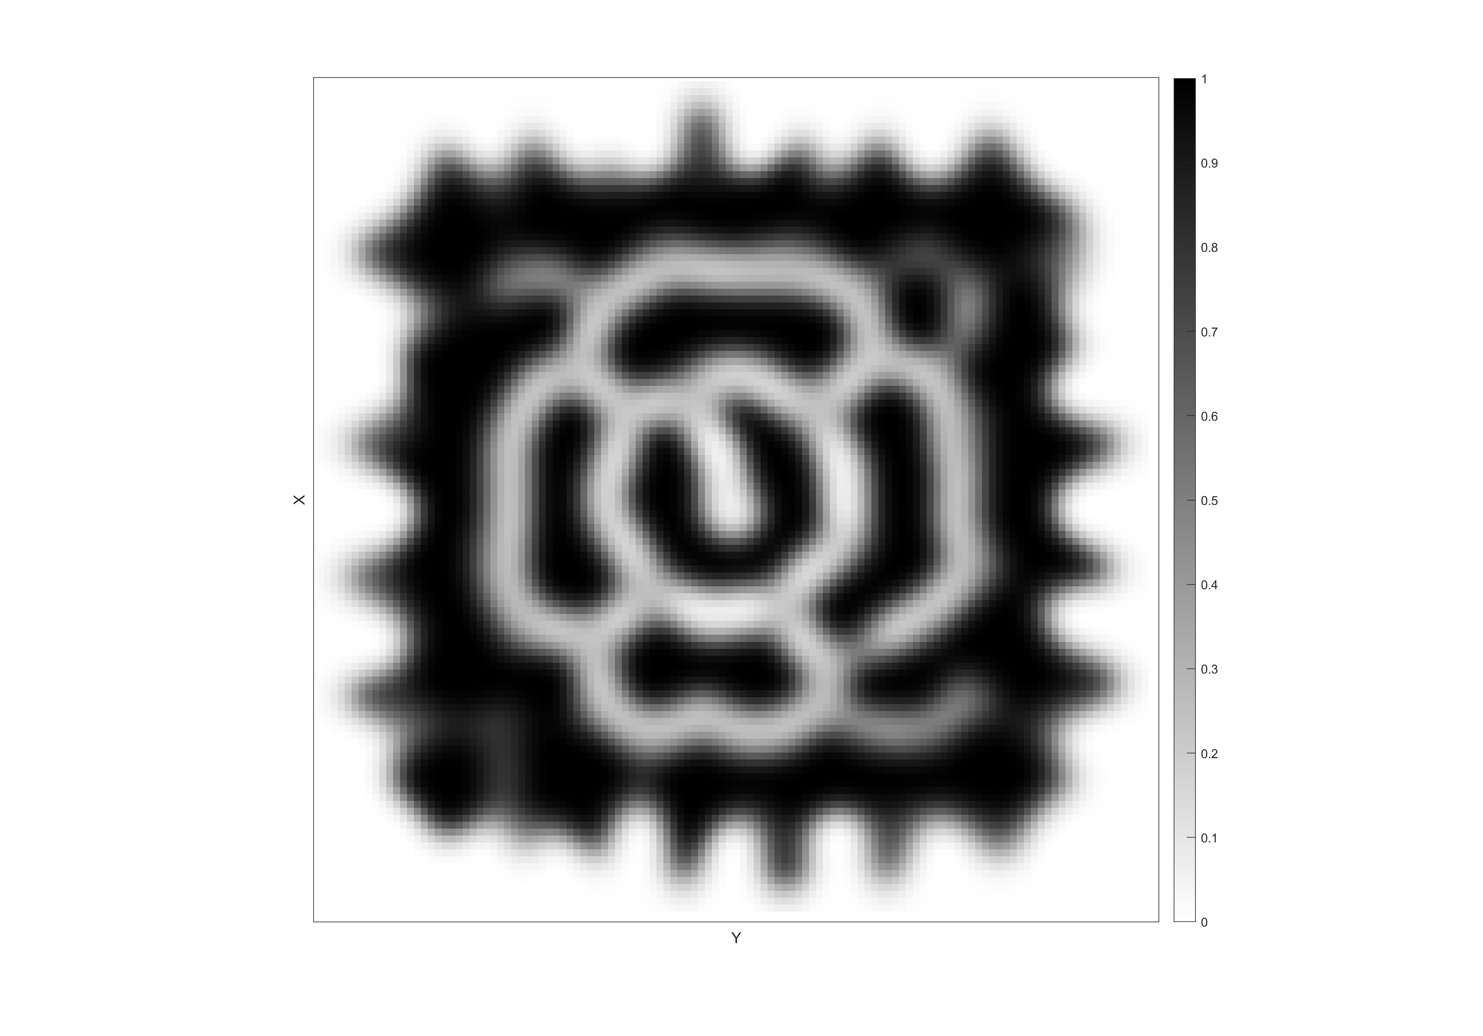

Convert the Heat Transfer Model for Topology Optimizations
To optimize the design, evaluating performance variations in response to design changes (gradient) is necessary.
For this reason, we describe the heat sink design as material density distribution ρ in a domain Ω
The domain Ω is discretized into voxels, and the heat sink is described by designating the density of each voxel
For final heat sink design, the density ρ of each voxel must either 0 or 1
The density can’t change abruptly from 0 to 1: this results intermediate design
The converted heat transfer model should still be able evaluate the “performance” when the density gradually changes from 0 to 1
Heat sink design as surface geometry
Heat sink design as material distribution (voxel)
Gradually Evolve the material distribution to optimize the heat sink design

Slide 6

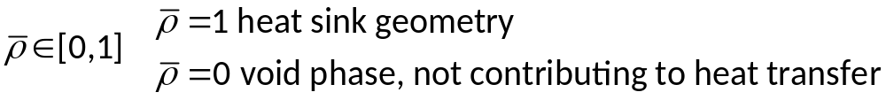
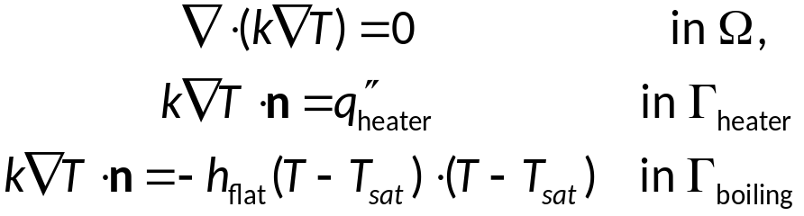
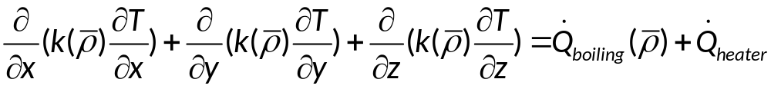
Converted Heat Transfer Model for Topology Optimizations
Design Space:
A field of physical density
Given the heat input, the boiling boundary condition h_{flat}(ΔT), and the material distribution of a heat sink, solve the temperature distribution.
Material Distribution: Physical density field within the computational Domain.
Material property: defined as a function of physical density.
The boiling heat sink boundary: cells where physical density changes drastically from 1 to 0.
Boundary condition: modeled as sources terms at the heat sink boundary.
Heated area
Discretization into voxel cubes

Slide 7
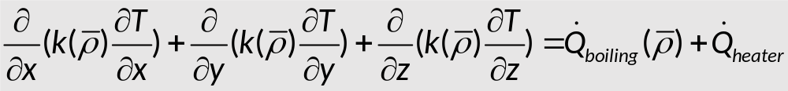

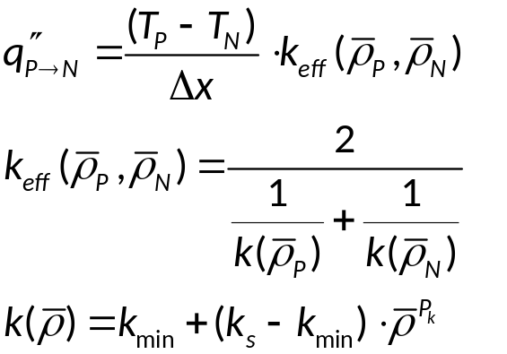

Discretized Heat Transfer Model for Topology Optimizations
In discretized form (2D for demonstration):
The design space is discretized into small voxels
Conduction between neighboring voxels is calculated as:
Interpolation scheme: solid isotropic material with penalization (SIMP)
Penalization parameters (P_{k}) is set to ensure the design correctly converges to “black and white” design.
N
N
P
N
N
*Each cube has a side length of Δx
k_{min} is needed to avoid singularity

Slide 8
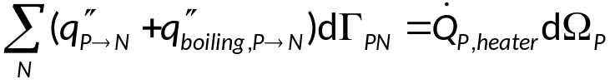

Discretized Heat Transfer Model for Topology Optimizations
In discretized form (2D for demonstration):
Convective heat loss of boiling between voxel P and N is defined as wall heat flux and applied as the source to voxel P:
Energy balance equation for voxel P is defined as:
The energy balance equations for each voxel (the governing physics) can then be written as a system of non-linear state equations:
N
N
P
N
N
*Each cube has a side length of Δx

Slide 9
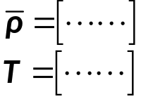
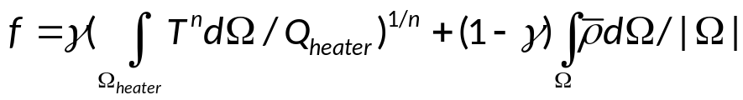
Topology Optimization Formulations
Governing Physics
3-D density and temperature field
Design and State Variable Vector
ρ: Physical density field vector, or design variable
T: Temperature field vector, or state variable
The 3-dimensional temperature and physical density distribution are described by the vector of design variable ρ and the vector of state variable T
The design variable and the state variable must satisfy the governing physics g(ρ,T) = 0
For a heat sink design described by density field ρ, the temperature state T can be solved from the governing physics
The target function f evaluates the performance of a given design ρ and state T
Topology optimization optimize the design ρ to minimize the target f
Topology Optimization Formulations
Target function
Governing physics
ρ: Physical density
Thermal resistance
mass
T: Temperature

Slide 10
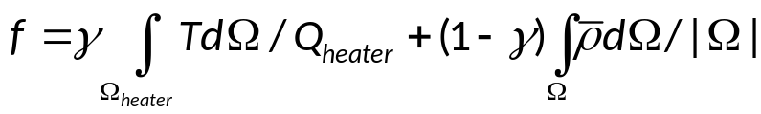
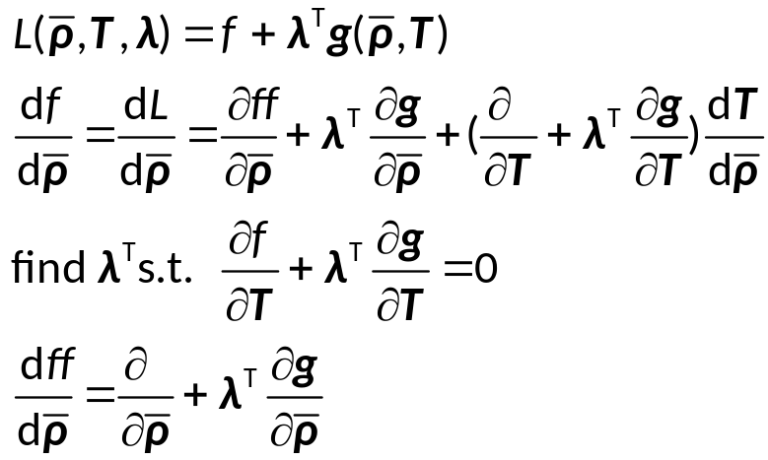
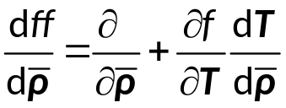
Topology Optimization Strategy:
Topology Optimization Formulations
Target function
It is hard to directly find the minimum of a multi-variable function f. Instead, the design is iteratively updated to minimize the target f.
Gradient based method are used to calculate the update step Δρ at each iteration.
Specifically, we use the method of moving asymptotes (MMA), which is an optimization algorithm for non-linear programming problems.
Whatever iterative algorithm is adopted, the gradient of target f to design ρ needs to be calculated.
However, we don’t directly calculate dT/dρ. Instead, we use adjoint method to implicitly calculate it.
Governing physics
ρ: Physical density
T: Temperature
Adjoint Method

Slide 11
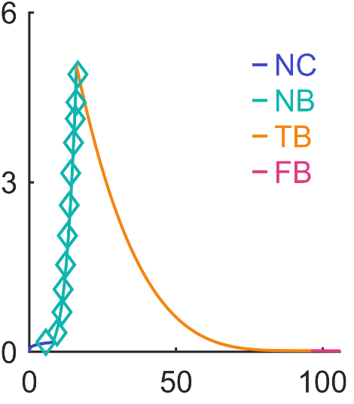
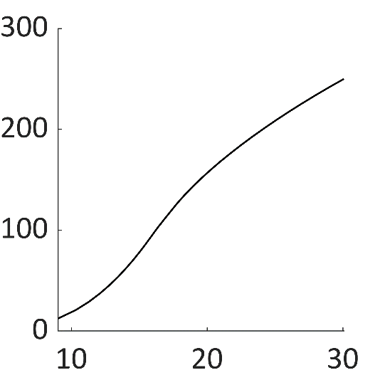

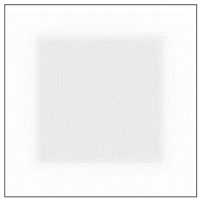

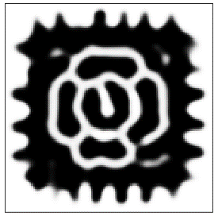


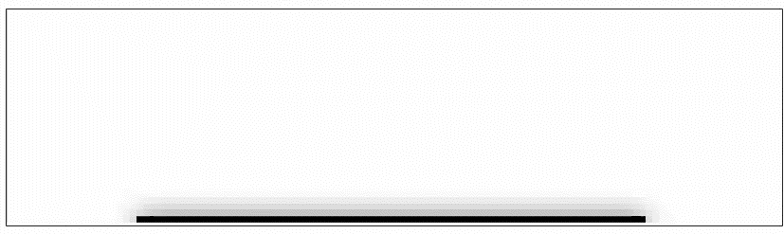
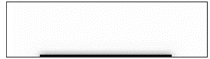

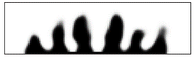
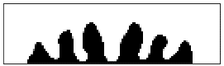
Boiling Heat Sink Optimization Example
Computational domain
h (ΔT) applied to the problem
Discretization:
120 × 120 × 32 voxels
Heat input:
900 W
Heat Sink Material:
Copper (390 W/mK)
20 mm
20 mm
h (W/cm²K)
8 mm
30 mm
30 mm
ΔT (K)
Predicted performance of optimized design
Rendered view of optimized heat sink
Design evolution
Iteration : 4
50
200
500
q’’ (W/cm²)
Y. Huang and J. A. Weibel (Manuscript In Preparation)
ΔT_{base} (K)
10

